Slide 1
Transformer
Model Architecture

Slide 2
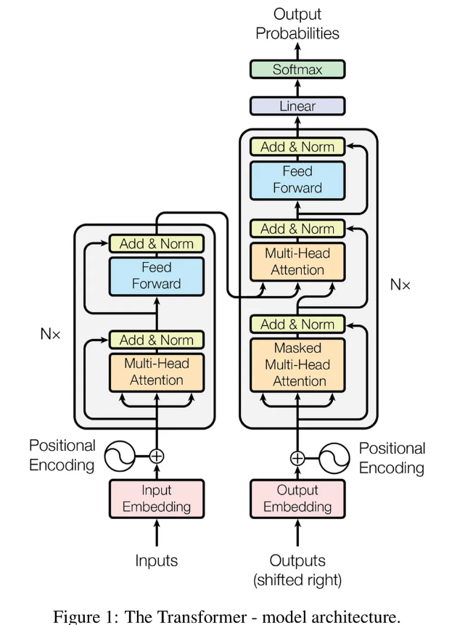

Slide 3
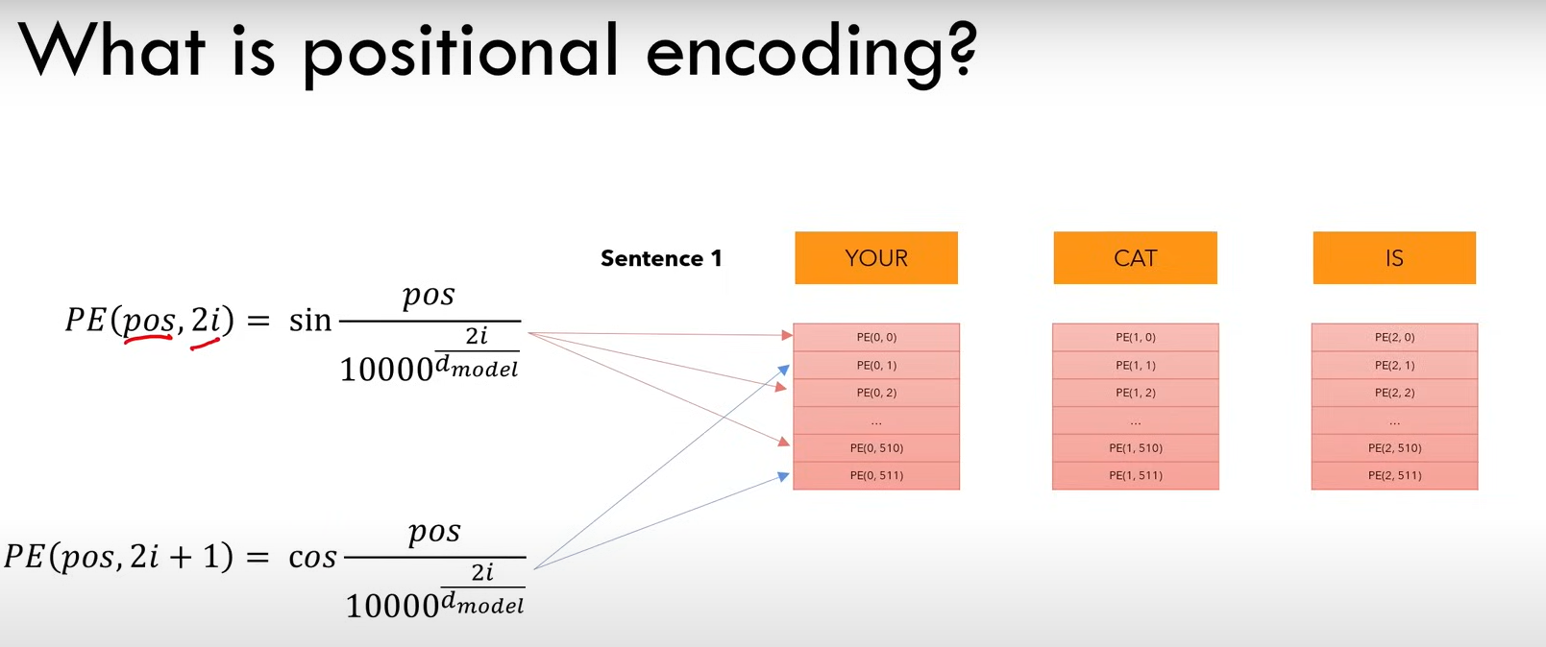

Slide 4
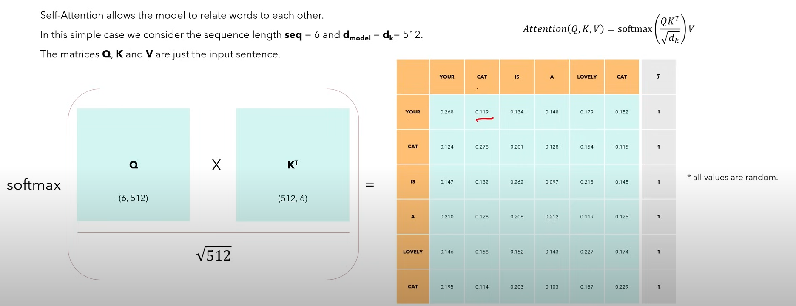

Slide 5
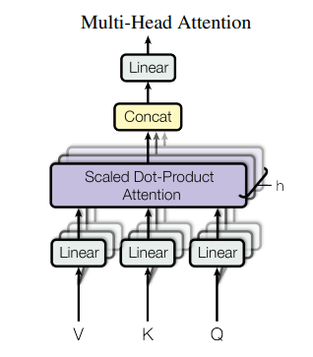
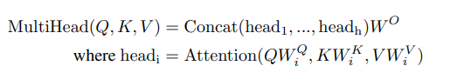

Slide 6
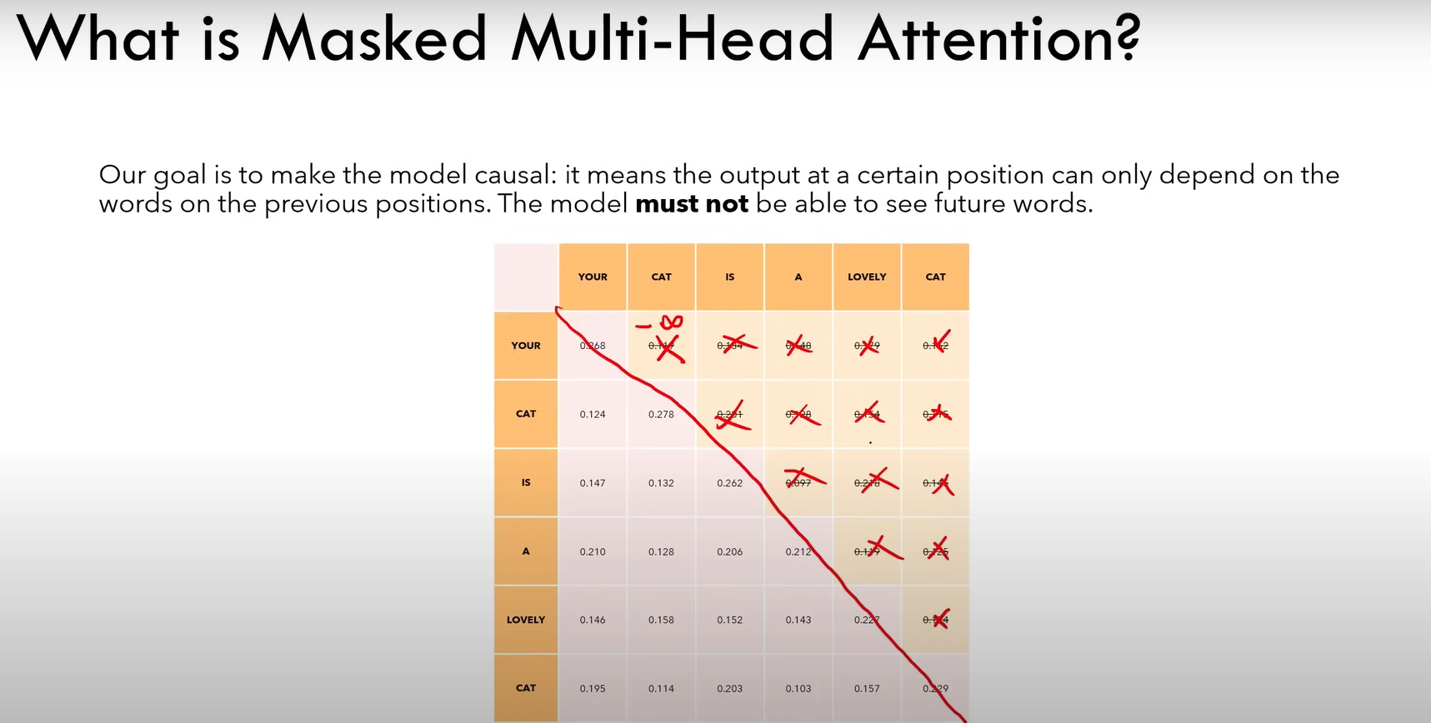

Slide 7
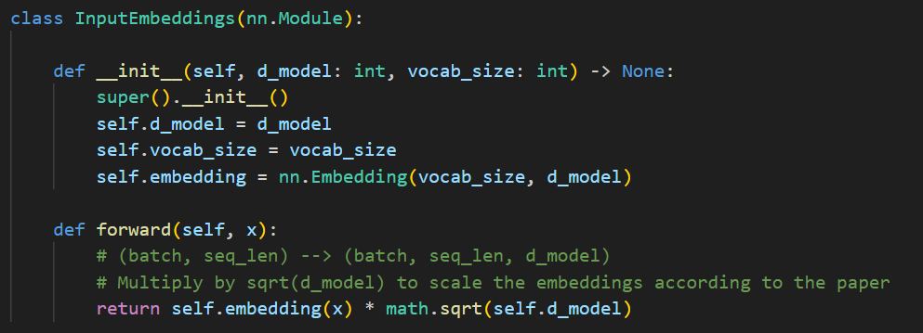
d_model: This parameter represents the dimensionality of the embedding vectors. Each token will be mapped to a vector of this length.
vocab_size: This parameter represents the size of the vocabulary, i.e., the total number of unique tokens that the model can handle.
self.embedding: This is an instance of nn.Embedding, which is a PyTorch module that creates a lookup table of embeddings.
It takes two arguments:
vocab_size: The size of the vocabulary.
d_model: The dimensionality of the embeddings.

Slide 8
x: The input tensor to the embedding layer, typically of shape (batch, seq_len), where:
batch is the batch size.
seq_len is the sequence length (e.g., the number of tokens in a sentence).
Reason to multiply by sqrt(d_model):
the class ensures that the input to subsequent layers has a controlled variance, which aids in the stability and efficiency of the training process.
As per the formula in attention score we divide the dot product by sqrt(d_model) hence to balance it we also multiply it to simplify our calculation.
How nn.Embedding Works
Initialization:
When you create an nn.Embedding layer, it initializes a matrix of shape (num_embeddings, embedding_dim) with random values. This matrix is the lookup table.
Forward Pass: During the forward pass, the input token indices are used to index into the lookup table to retrieve the corresponding embedding vectors.
Learning: The embedding vectors are updated during the training process through backpropagation, just like other parameters in the neural network. This allows the embeddings to capture useful properties about the tokens based on the task.
Use Cases:
Word Embeddings: In NLP, nn.Embedding is often used to learn word embeddings. Words in a vocabulary are mapped to vectors in a continuous space where similar words are close to each other.
Categorical Data: It can also be used to handle categorical data in other domains where categories need to be represented as continuous vectors.

Slide 9
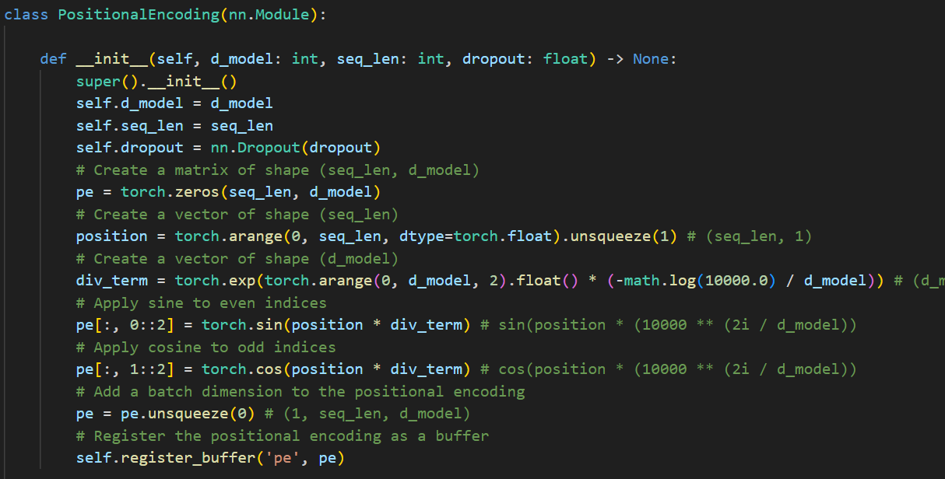
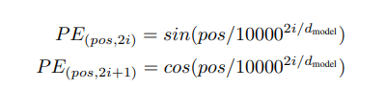

Slide 10
Pe is registered as a buffer using self.register_buffer('pe', pe), which means it will be part of the model state but not a learnable parameter similar is the role of req_grad(False).
Includes batch size i.e in the formula pe.unsqueeze(0) as initially pe shape was (seq_len, d_model) -> (1,seq_len,d_model) after def_forward its resultant shape would be (batch,seq_len,d_model).
In the PositionalEncoding class, the dropout layer is used to regularize the positional encodings by randomly zeroing out parts of the tensor during training. This helps in preventing overfitting and ensures the model learns more robust features. During evaluation, dropout is turned off, and the full positional encodings are used. But while training dropout will be activated.

Slide 11
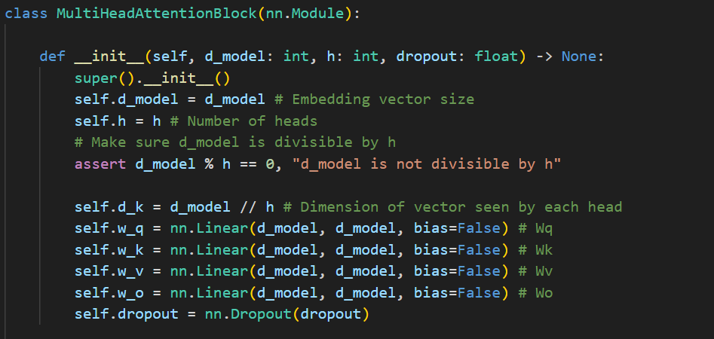

Slide 12
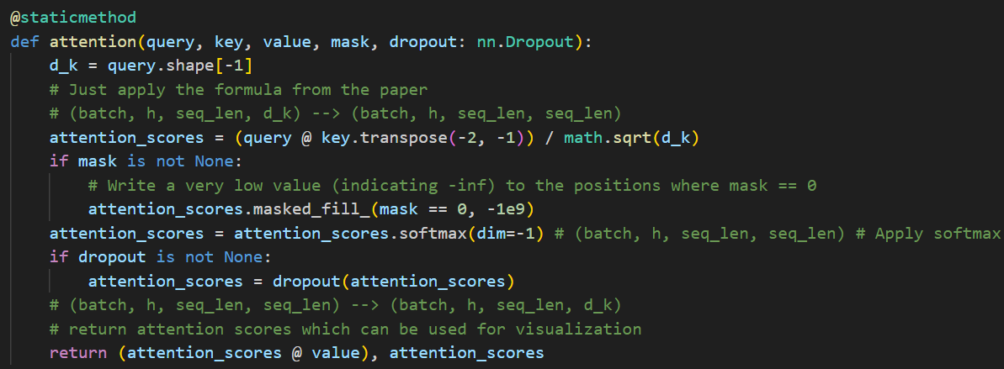
The shapes of these tensors before the transpose operation are:
query: (batch_size,num_heads,seq_len,d_k)
key: (batch_size,num_heads,seq_len,d_k)
After transpose
The key dimension will change to -> (batch_size,num_heads,d_k,seq_len).
The resulting shape of the attention scores will be:
(batch_size,num_heads,seq_len,seq_len)

Slide 13
Each element in attention_scores represents the raw compatibility score between a query and a key.
Purpose of Softmax
The purpose of applying the softmax function to the attention scores is to convert these raw scores into probabilities. The softmax function ensures that the scores are normalized:
The sum of the scores for each query across all keys is 1.
The values are between 0 and 1.
Why dim=-1?
The dim=-1 argument specifies that the softmax function should be applied along the last dimension of the tensor. This last dimension corresponds to the different keys for each query.
Reason to use @staticmethod
It is used to define a method within a class that doesn’t access or modify the class state.
i.e this means the method doesn’t uses the instances (like ‘self’) or class (‘cls’) parameters.

Slide 14
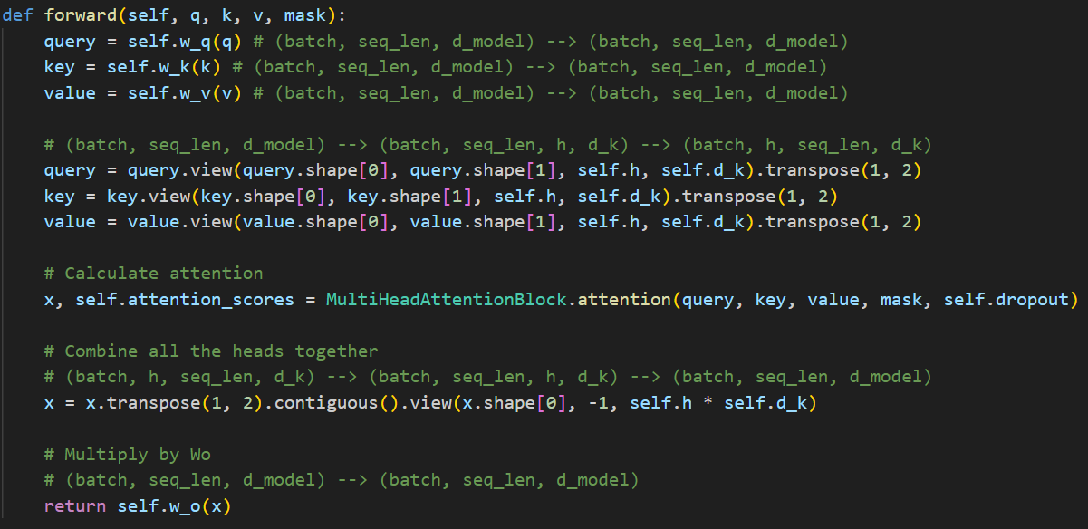

Slide 15
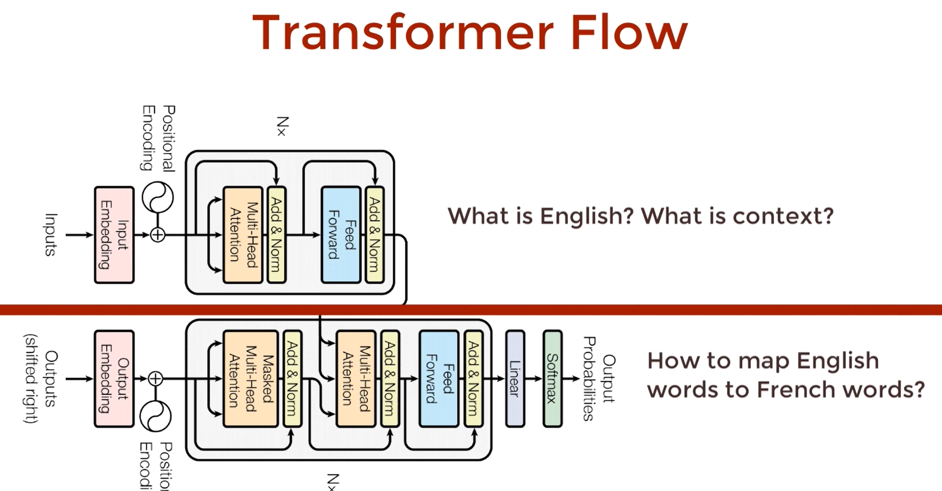

Slide 16
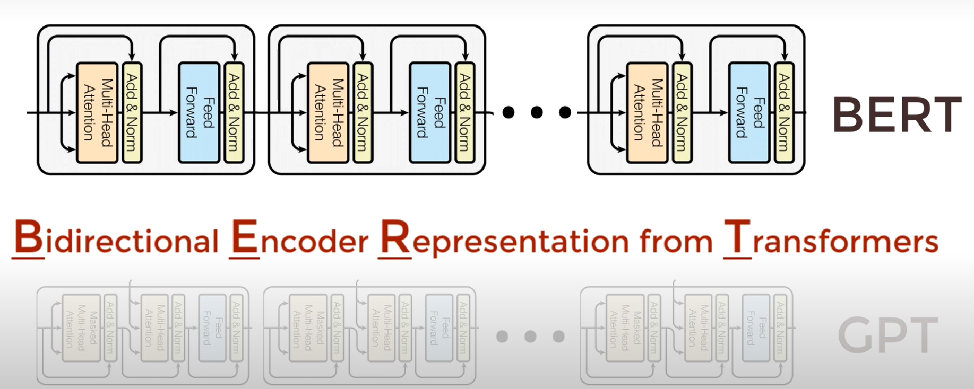
BERT(Bidirectional Encoder Representations from Transformers)

Slide 17
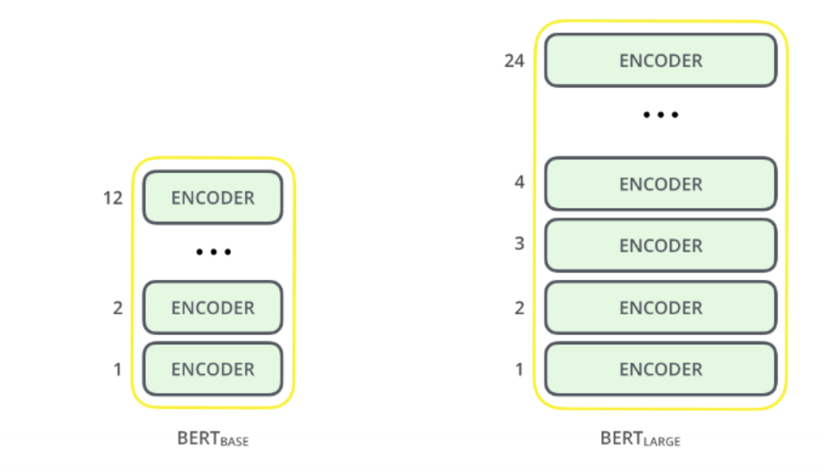
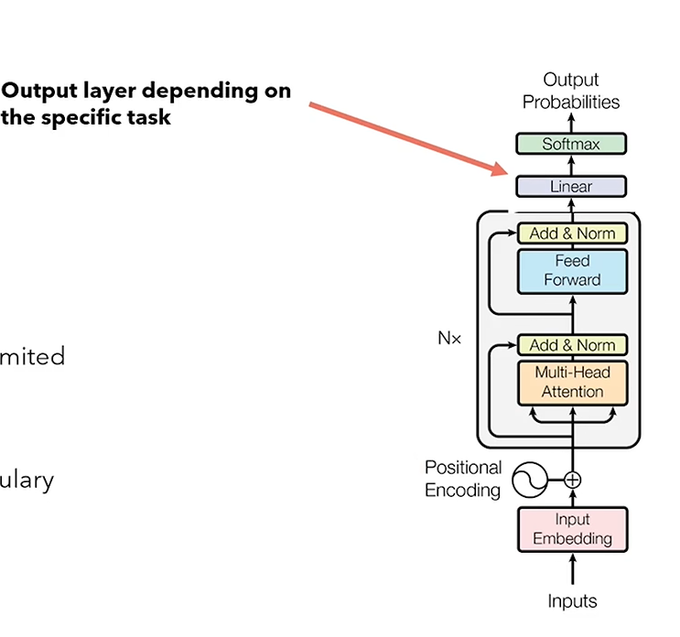







BERT Base: 12 layers (transformer blocks), 12 attention heads, 110 million parameters and 768 hidden size (word emebedding size).
BERT Large: 24 layers (transformer blocks), 16 attention heads, 340 million parameters and 1024 hidden size.

Slide 18
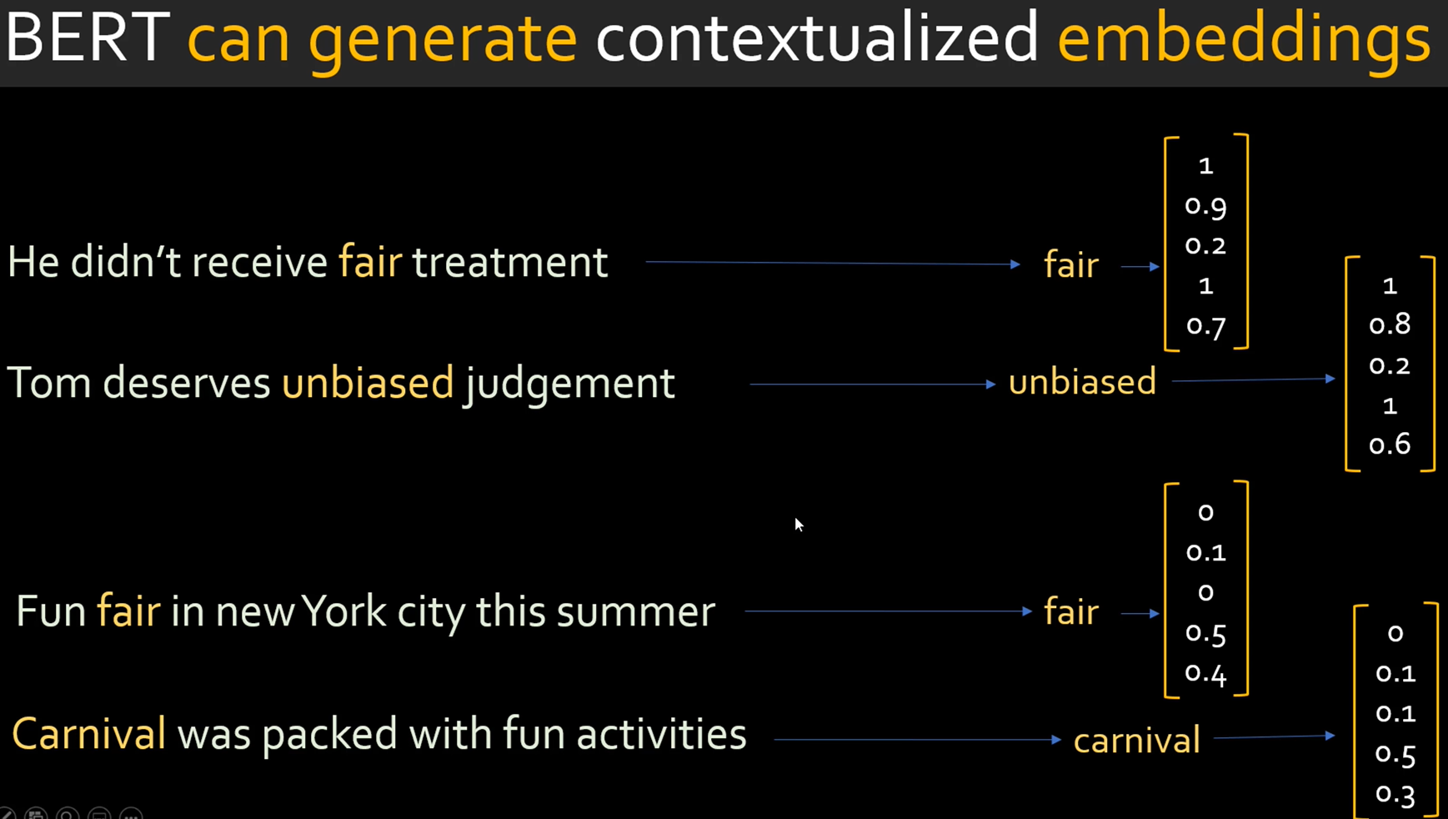

Slide 19
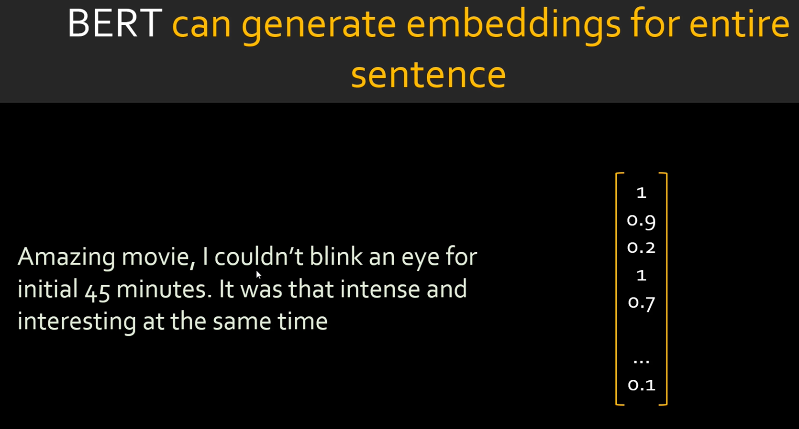

Slide 20
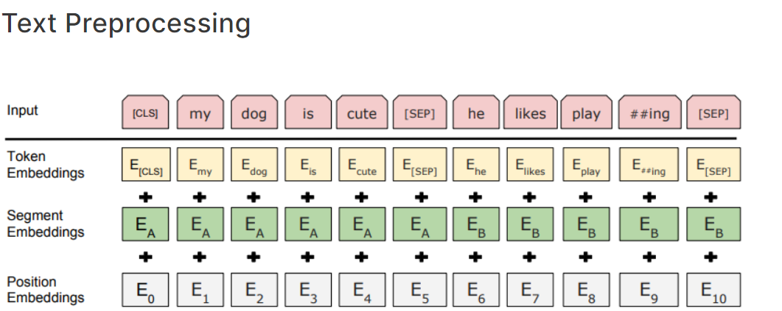
Embeddings:
Token Embeddings: Embeddings for individual tokens.
Segment Embeddings: Different embeddings to distinguish between two sentences in NSP tasks.
Positional Embeddings: Encodes the position of each token in the sequence.
Input Representation:
BERT uses WordPiece embeddings with a 30,000 token vocabulary.
The input representation is a combination of token embeddings, segment embeddings, and positional embeddings.
Tokens are packed into fixed-length sequences, and special tokens [CLS] (classification) and [SEP] (separator) are added to the beginning and end of the sequences respectively.

Slide 21
WordPiece:
It is a subword tokenization method. Instead of splitting text into words, it breaks text down into smaller units (subwords or wordpieces). This approach allows the model to represent words more effectively, especially rare words or misspellings, by leveraging common subword units.
How WordPiece Works
Initialization:
Start with a basic vocabulary of all individual characters in the language (e.g., 'a', 'b', 'c', ..., 'z') and special tokens (e.g., '[CLS]', '[SEP]').
Tokenization:
Split words into characters initially. For example, the word "playing" would be split into ['p', 'l', 'a', 'y', 'i', 'n', 'g'].
Training the Vocabulary:
Use a large corpus to learn common subword units. The goal is to iteratively merge character sequences to form subwords that maximize the likelihood of the training data.
At each iteration, the pair of tokens (subwords) that appears most frequently together is merged to form a new token. For example, if 'pl' appears frequently, it might be merged into a single token 'pl'.
This process continues until a predefined vocabulary size is reached.
Building the Final Vocabulary:
The final vocabulary contains subwords of varying lengths, optimized to represent the training data effectively. This vocabulary includes common subwords like 'play', '##ing', '##ed', and individual characters for very rare words.
Example playing could be broken down and belong to any of token as “play” or “##ing”.

Slide 22
BERT pre-training: (Unsupervised or semi supervised task)
Masked Language Model Task
Next Sentence prediction
BERT fine-tuning: (Supervised task)
Text Classification Task
Question Answering Task
Note: (from paper)
During pre-training, the model is trained on unlabeled data over different pre-training tasks. For fine tuning, the BERT model is first initialized with the pre-trained parameters, and all of the parameters are fine-tuned using labeled data from the downstream tasks.

Slide 23
Key Innovations in BERT:
Bidirectional Contextualization:
Unlike traditional models (e.g., RNNs, LSTMs) which read the text either from left to right or right to left, BERT reads text in both directions simultaneously. This allows BERT to understand the context of a word based on its surroundings more effectively.
Pre-training Tasks:
Masked Language Modeling (MLM): Randomly masks some of the tokens in the input and the task is to predict the masked words based on their context. This helps the model learn deep bidirectional representations.
Next Sentence Prediction (NSP): A binary classification task to predict if a given sentence B follows sentence A. This aids in understanding the relationship between two sentences.
Pre-training Tasks
BERT is pre-trained using two unsupervised tasks:
Masked Language Model (MLM):
Randomly masks 15% of the tokens in the input sequence and the model is trained to predict these masked tokens based on their context. If the i-th token is chosen, we replace the i-th token with (1) the [MASK] token 80% of the time, a random token 10% of the time, the unchanged i-th token 10% of the time. Then, Ti will be used to predict the original token with cross entropy loss.
Example: "The cat sat on the [MASK]." The model should predict the masked word "mat".
Next Sentence Prediction (NSP):
A binary classification task where the model predicts if a given sentence B is the actual next sentence that follows sentence A.
Example: Given sentence A: "The man went to the store." and sentence B: "He bought a gallon of milk." The model should predict that B follows A.
When choosing the sentences A and B for each pre training example, 50% of the time B is the actual next sentence that follows A (label as IsNext), and 50% of the time it is a random sentence from the corpus (label as NotNext).
Note:
The maximum size of each sentence in bert base is 120 tokens.

Slide 24
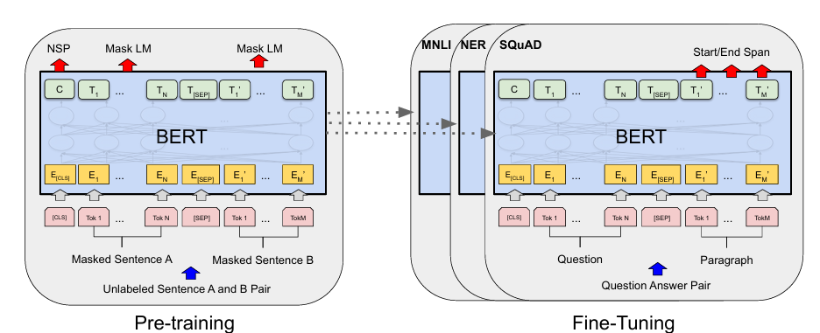

Slide 25
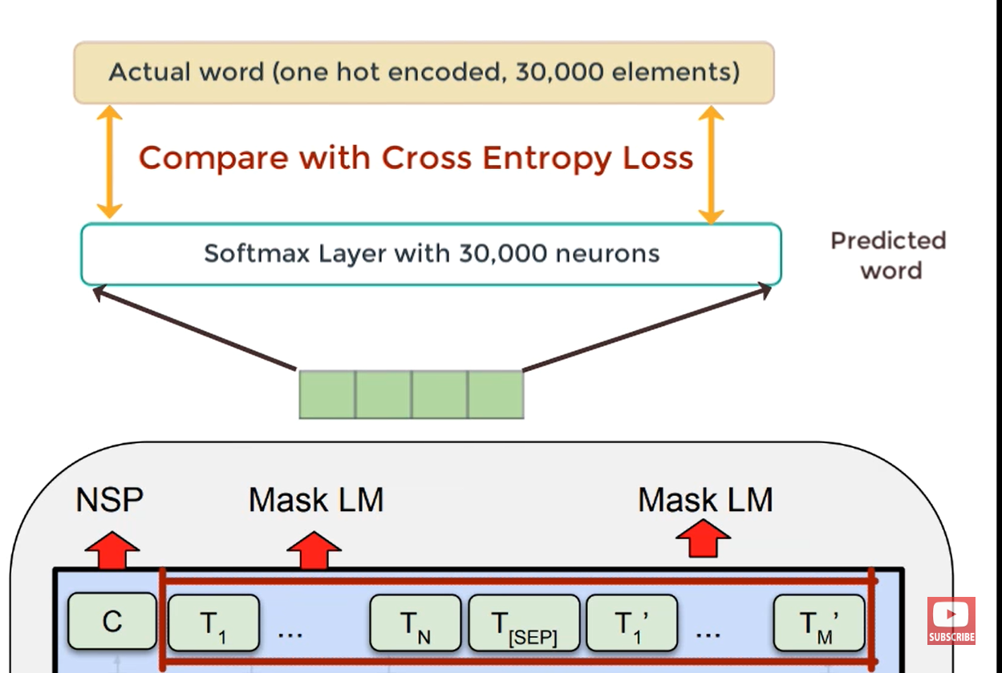

Slide 26
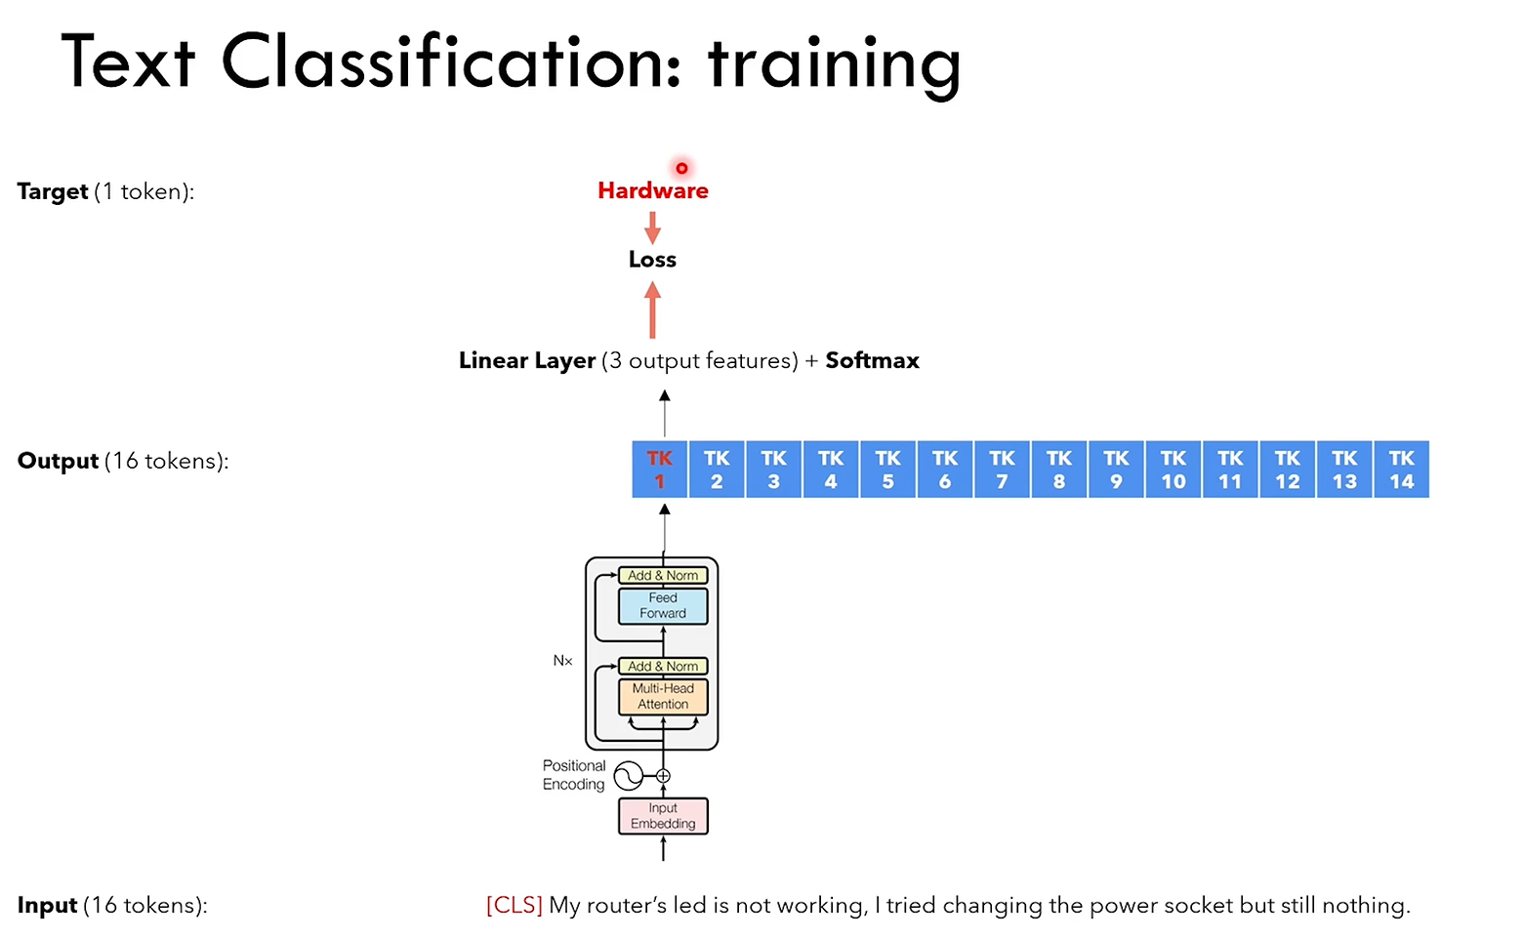

Slide 27
Key Reasons Why BERT is Bidirectional:
1. Masked Language Model (MLM) Objective:
Bidirectionality: Because the model uses the full context of the sentence, both to the left and right of the masked token, it can learn to understand the meaning of each word in relation to its surrounding words, making it inherently bidirectional. This approach allows BERT to grasp the nuanced meanings of words based on their context more effectively than unidirectional models.
2. Next Sentence Prediction (NSP) Objective:
Bidirectionality: By understanding the relationship between pairs of sentences, BERT can capture long-range dependencies and the flow of information across sentences. This task further enhances the model's ability to understand context in a bidirectional manner.
Dataset used: (While pre-training)
BooksCorpus (800M words)
English Wikipedia (2,500M words)
Dataset used: (While fine-tuning)
SQuADv1.1 (Q-Ans) (short ans type)
SQuADv2.0 (no short ans exists in the provided paragraph, making the problem more realistic)
SWAG (sentence pair dataset on Advertisement)

Slide 28
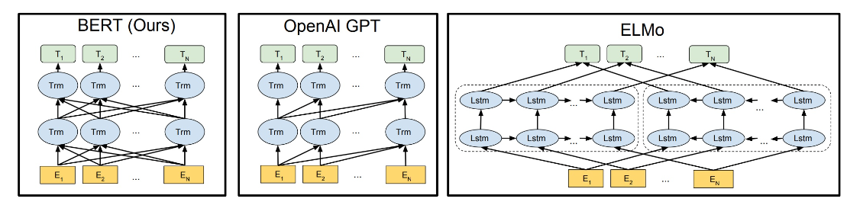
We had language models either trained to predict the next word in a sentence (right-to-left context used in GPT) or language models that were trained on a left-to-right context. This made our models susceptible to errors due to loss in information.
ELMo tried to deal with this problem by training two LSTM language models on left-to-right and right-to-left contexts and shallowly concatenating them. Even though it greatly improved upon existing techniques, it wasn’t enough.

